Slide 1

TITLE: SMART SALINE BAG
St Joseph’s College of Engineering
Team Name : ConnecTech Crew
TEAM MEMBERS: Dharshinisri.G (EEE)
Ashwini.D(EEE)
Anbarasi.P(EEE)

Slide 2
PROBLEM STATEMENT:
However, the difficulties of overloaded hospitals frequently impede the seamless administration of this critical care. Currently, manual monitoring of IV drip levels is the responsibility of nurses and hospital employees. Unfortunately, their hectic schedules might lead to mistakes and omissions. Acknowledging the significance of tackling this core problem, the suggestion involves the creation of an independent, self-regulating drip monitoring system utilizing Internet of Things (IoT) technology.
Notes:
PROBLEM STATEMENT:
However, the difficulties of overloaded hospitals frequently impede the seamless administration of this critical care. Currently, manual monitoring of IV drip levels is the responsibility of nurses and hospital employees. Unfortunately, their hectic schedules might lead to mistakes and omissions. Acknowledging the significance of tackling this core problem, the suggestion involves the creation of an independent, self-regulating drip monitoring system utilizing Internet of Things (IoT) technology.

Slide 3
Project Goal
“Good health and well being ensures healthy lives and promote well-being for all at all age”
How It is Related To Our Project:
The IV drip monitoring system is to ensure the safe and effective
delivery of fluids and medications to patients in healthcare settings
which inturn provide good health and well being of people at all age

Slide 4
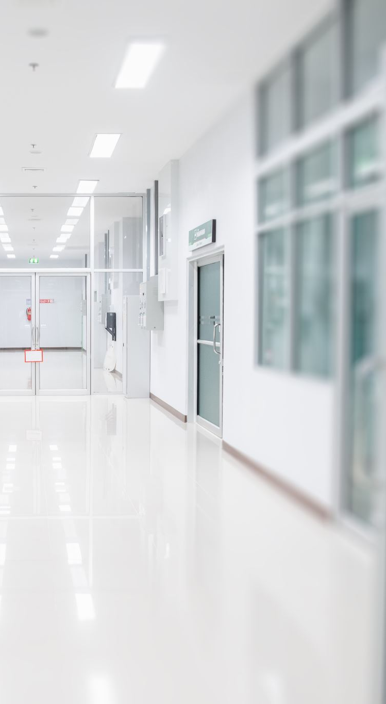
ABSTRACT:
The IOT based IV bag monitoring system project is the effective system for monitoring IV fluid bags (saline bags) in hospitals . IV therapy is an essential part of patient care in healthcare facilities , and the safe and efficient delivery of IV fluids is crucial for patient recovery.
The current manual systems can lead to errors, such as incorrect flow rates, insufficient or excessive fluid delivery, and delays in replacing empty bags. however,managing IV bags can be a challenging task for healthcare staff.
The proposed solution is to develop a smart and efficient monitoring system for IV fluid bags using IOT technology.

Slide 5
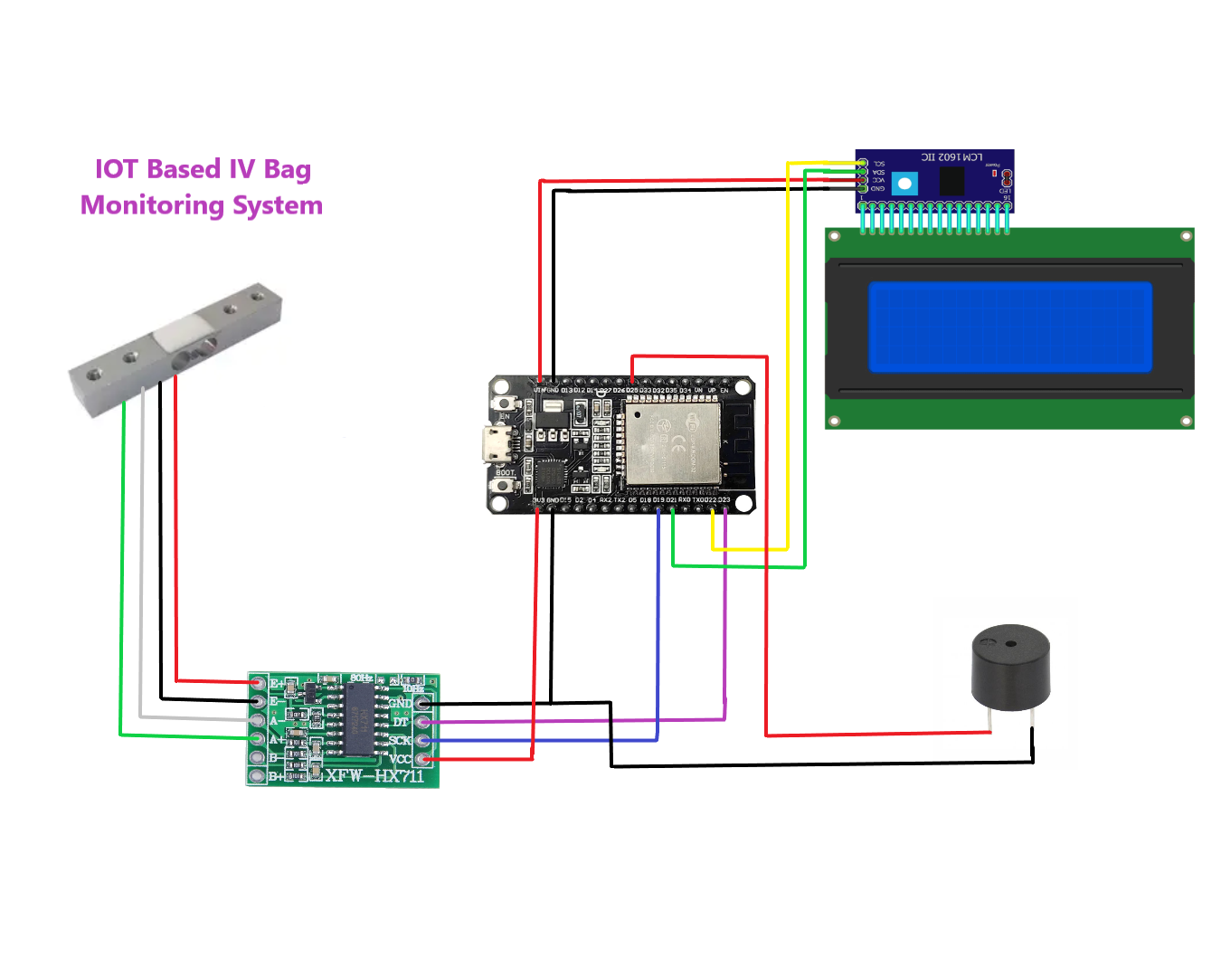
BLOCK DIAGRAM:
This project basically has ardino has a main component and it is connected to a 16*2 LCD display thereby it is joined with 5kg load cell and a buzzer is which indicates the level of saline bag when it is decreasing and it is linked with the blynk server which shows percentage of saline bag using IOT.
Notes:
BLOCK DIAGRAM:
Power Supply
|
Esp32 Dev module--→Lcd Display (16×2)
(Output)
|
HX711 Amplifier
|
Load cell (5 kg)

Slide 6
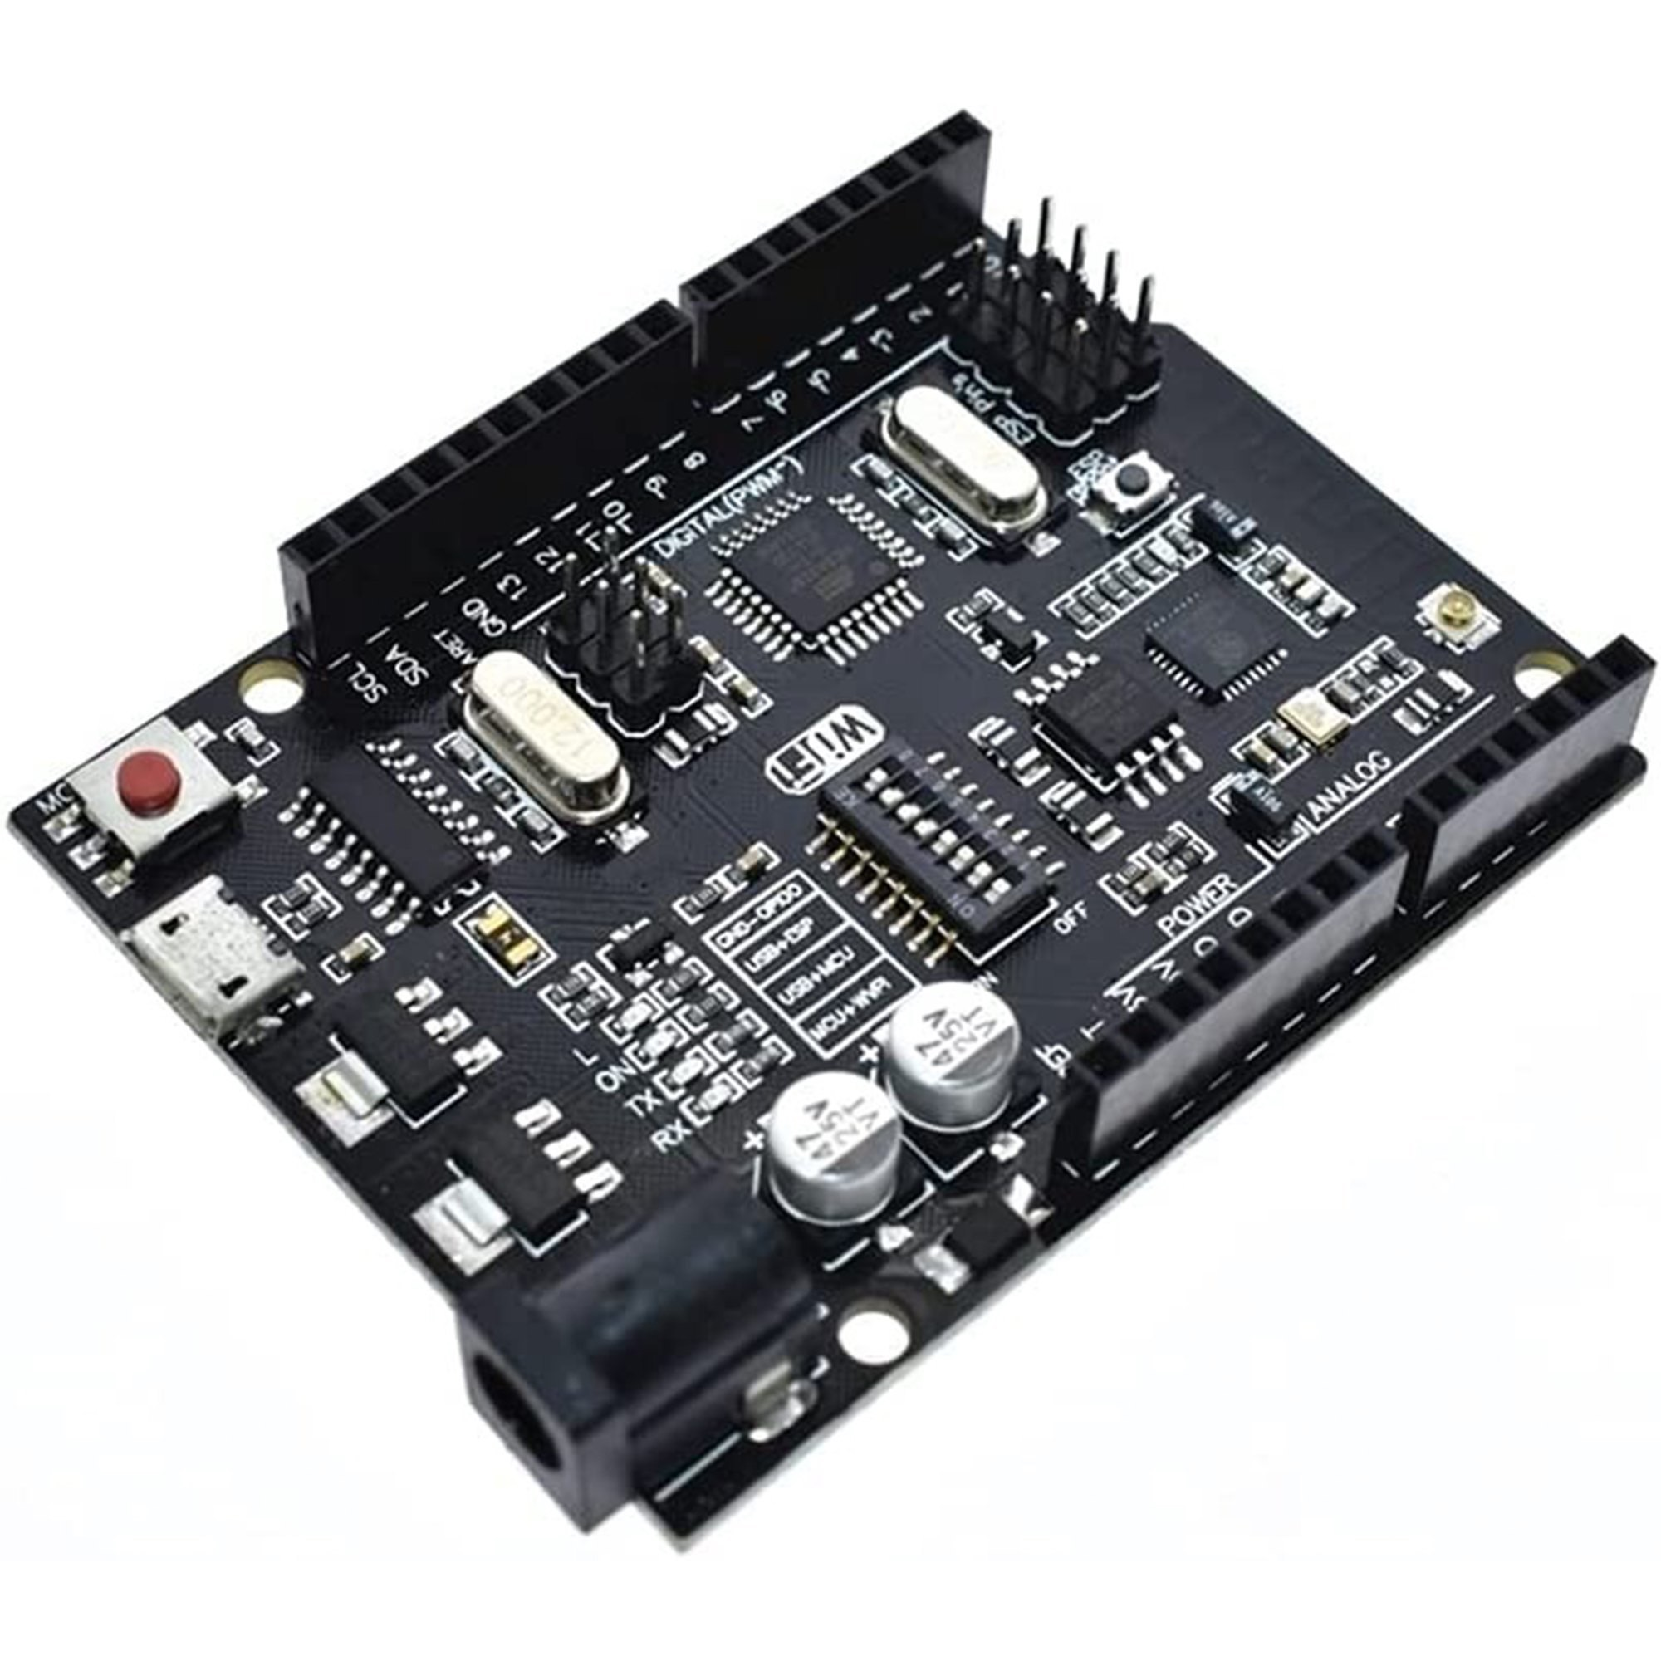
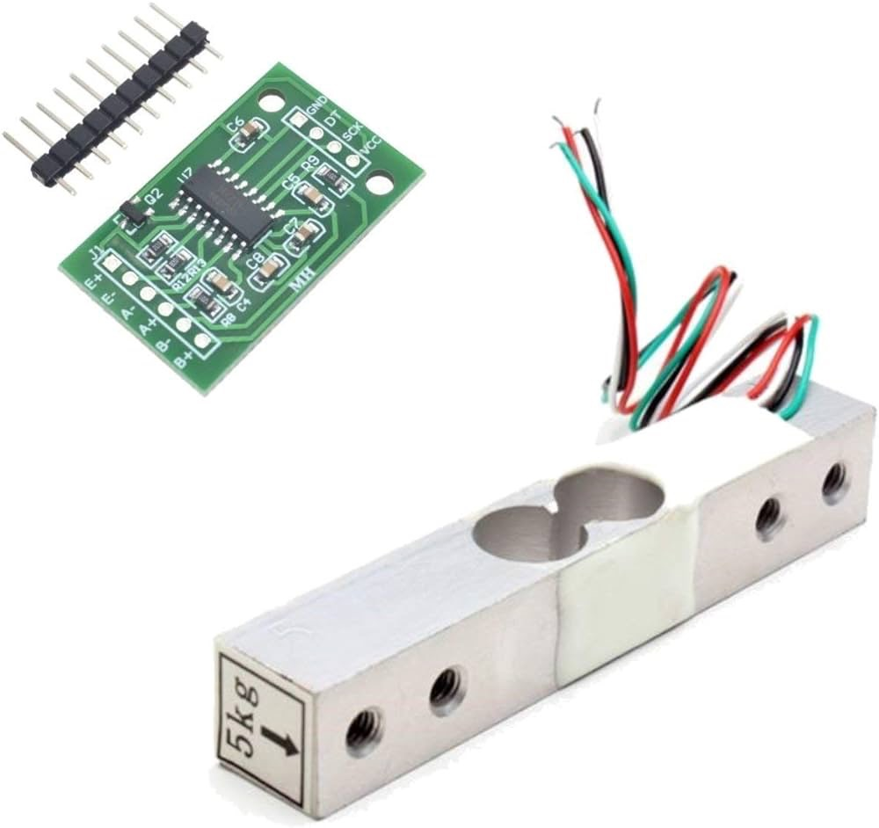
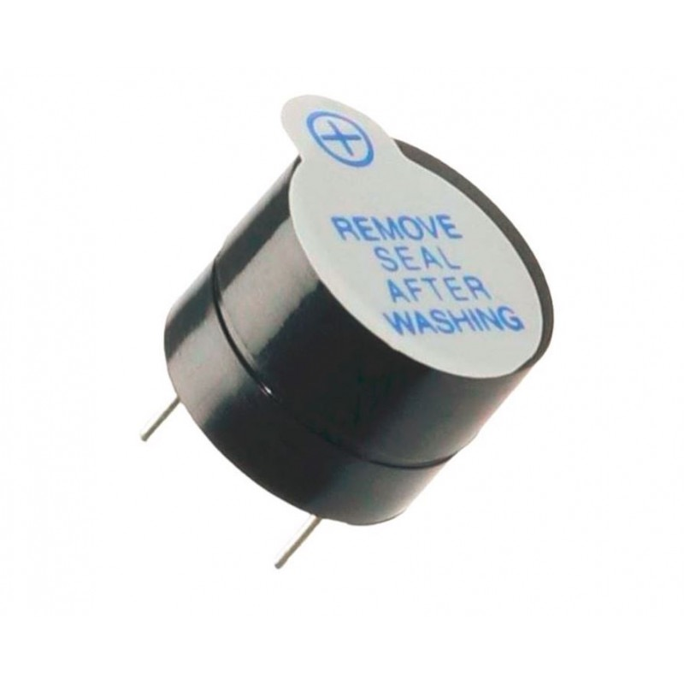
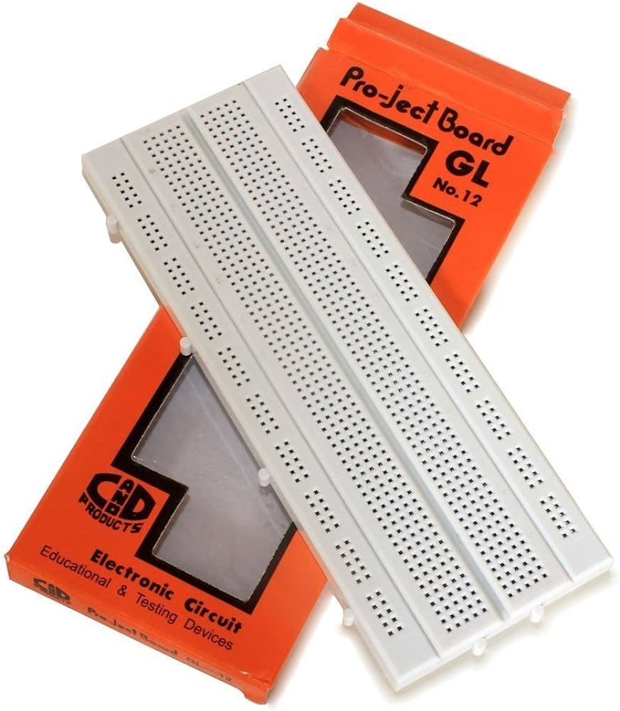
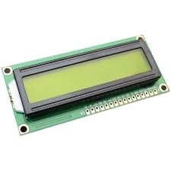
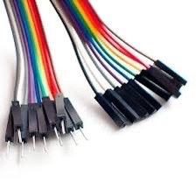
List of Components Used:
Ardino Atmega328
5 Kg load cell
5 V Magnetic Buzzer
16*2 LCD Display
Jumper Wires
Bread Board

Slide 7
Olden Existing System | IOT Based Project
Accidents related to the administration of intravenous(IV) medication,such as drug overdose/underdose,drug/patient mis-indentification,and delayed bag exchange,occur consistently in clinical fields. | In this study, we proposed a smart IV pole that can monitor the infusion status of IV medications. With IOT,data is transferable over a network without requiring human-to-human-to-computer interactions.
Several previous studies have suggested various contact-sensing and image-processing methodologies;however,most of them can increase the workload of nursing staffs during long-term,continuous monitoring. | So to summarise,an IOT network is a closed-loop mesh of automously operating devices which can communicate with each other when required,while regular networks rely on readiness to connect with an external system.

Slide 8

Advantages:
Improved operational efficiency.
Data-driven insights for quick decision-making.
Real-time assert/resource visibility.
End-to-end ,remote monitoring and management of asserts/resources.
Real-time, predictive and prescriptive insights.

Slide 9

Applications:
Remote patient monitoring.
Glucose monitoring.
Hand Hygiene monitoring.

Slide 10

Future Scope:
Personalized healthcare IOT devices will allow for real-time collection of health data.
It can then be used to create tailored treatment plans for individual patients.
This will lead to more effective treatment and better outcomes for patients.

Slide 11
THANK YOU….

